Slide 1
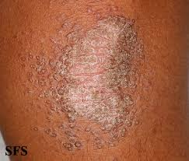
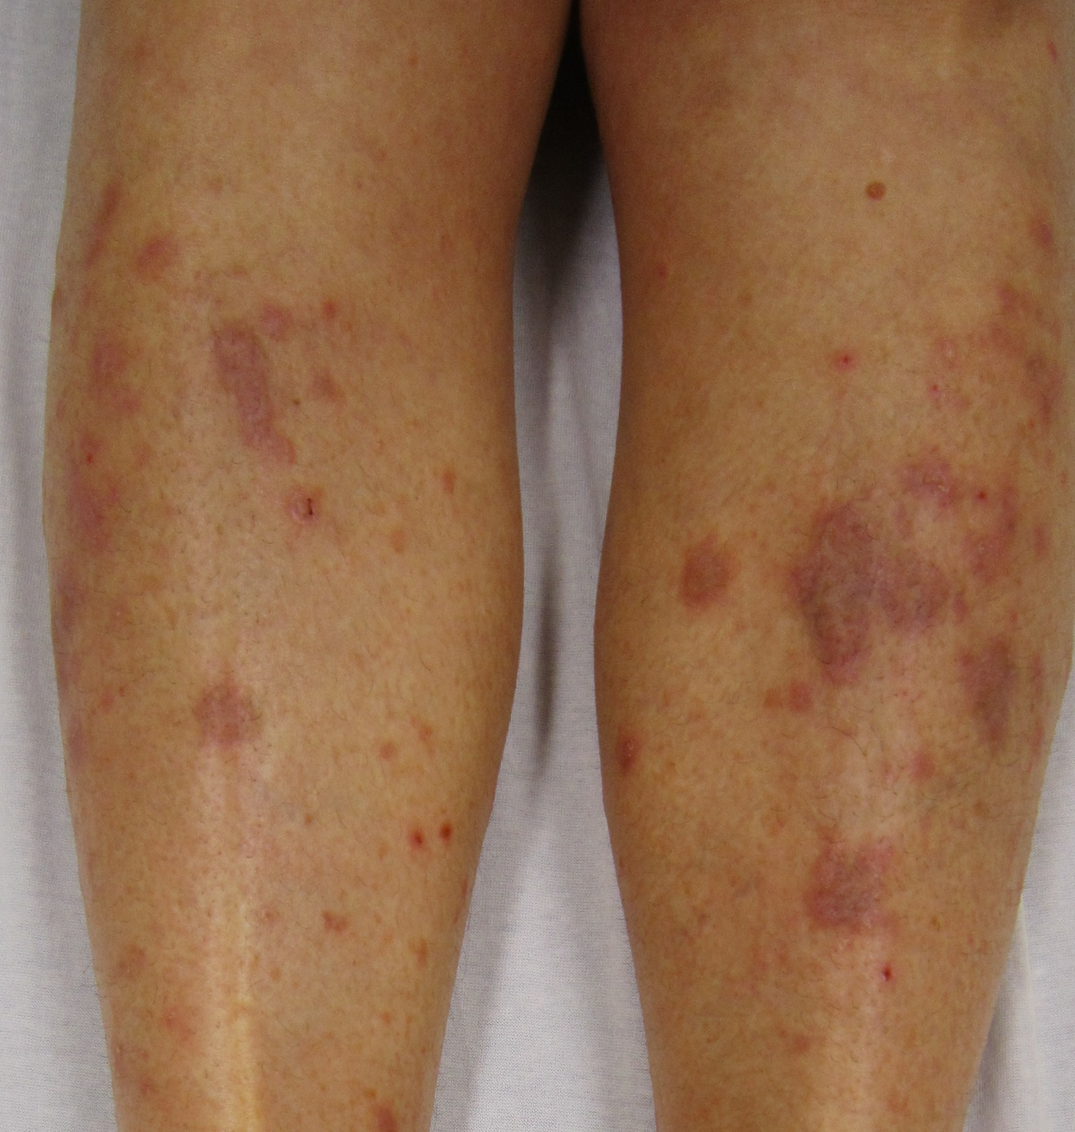
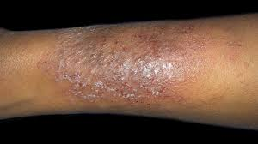
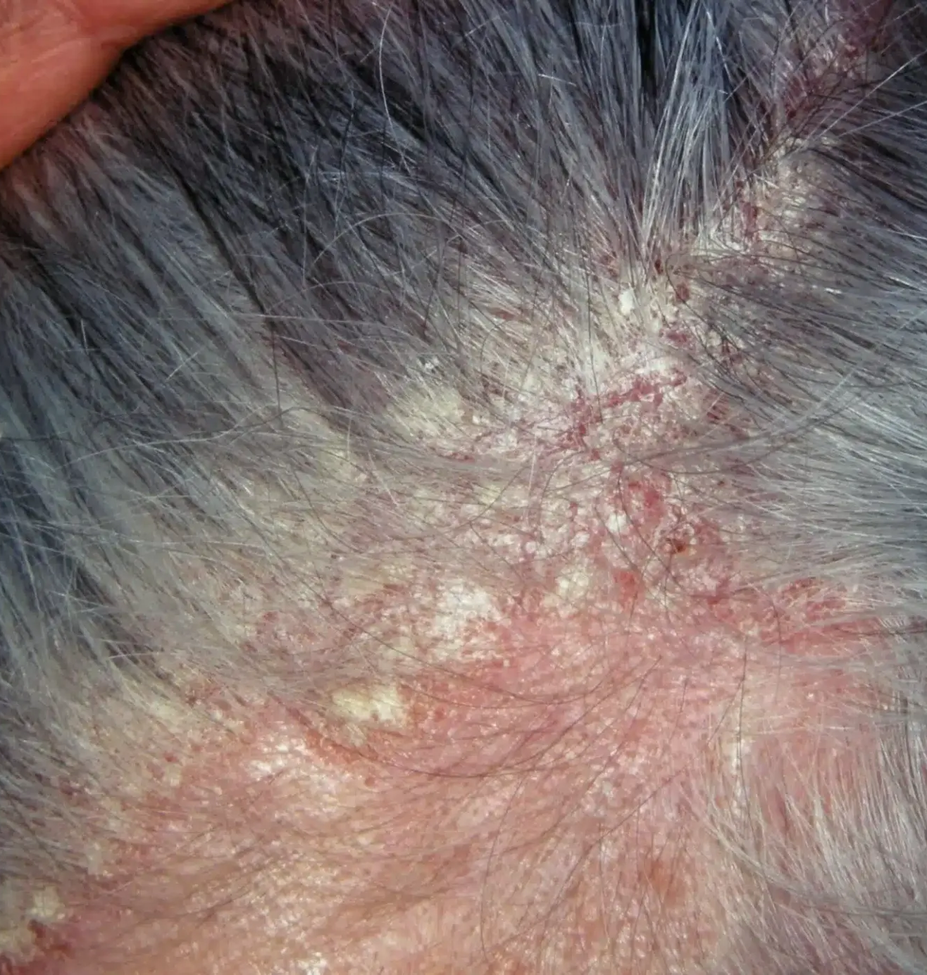
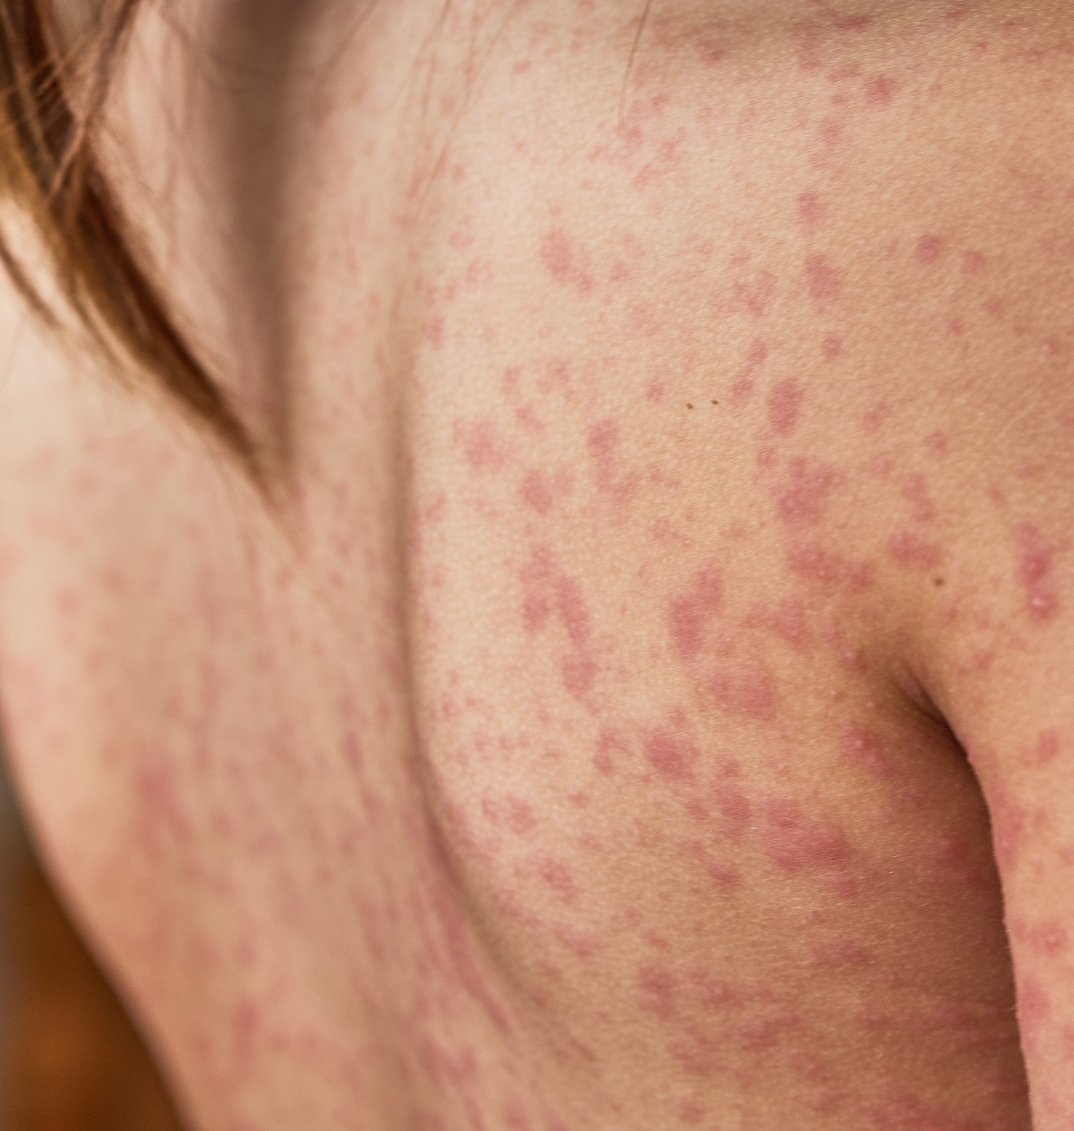
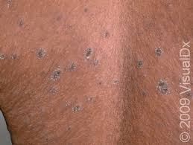
pityriasis rubra pilaris
chronic dermatitis
Lichen Planus
Lichen planus is an inflammatory skin condition that causes purple, itchy, and sometimes painful rashes on the skin.
Seborrheic Dermatitis
Psoriasis
pityriasis rosea
Seborrheic dermatitis is a common skin condition that causes a red, itchy, flaky scalp, often known as dandruff.
Psoriasis is a chronic skin condition characterized by red, scaly patches that can be itchy and painful.

